Slide 1


Language Detection
Isabella Sturm

Slide 2
Business Problem
With thousands of languages spoken around the world, being able to detect which language is used (in written language for this project), makes it possible to find proper translations so text can be read and understood
Some existing use cases include automatic translations provided for posts/comments on social media apps and Google’s translations based on detected language

Slide 3
Background
About 7,000 language spoken around the world today
English is the most spoken language, and is taught in many schools in Europe
Over 3.5 billion people use social media worldwide, projected to be over 4 billion in the next few years
Being able to connect to people across the world means language detection is an important step to achieving this

Slide 4
Data – Tatoeba Dataset
Column | Description
Sentence id | Unique identifier
Lang | ISO-639-3 language code
Text | Sentence
~ 7 million sentences in over 300 languages submitted by users around the world
Split this into 2 sample datasets
First dataset: Top 21 languages based on people in the world who speak those languages. 500 samples per language
Second dataset: Top 25 languages based on most samples available in the dataset 50,000 samples per language

Slide 5
ISO 639-3 Dataset
Column | Description
639-3 | ISO 639-3 language code
639-2/639-5 | ISO 639-2/639-5 language code
639-1 | IS 639-1 language code
Language Name(s) | Language that correlates to the language names
Scope | Whether language is Individual or Collective
Language Type | Whether language is Living, Extinct, Genetic, Constructed

Slide 6
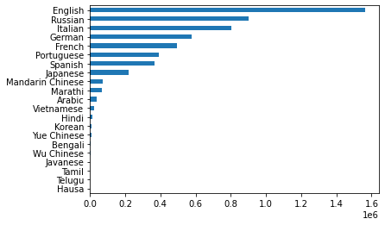
Data Exploration
Bar chart of Top 21 Languages (by population)
English 1564640 Russian 900863 Italian 801269 German 578833 French 493072 Portuguese 392730 Spanish 366050 Japanese 218246 Mandarin Chinese 71952 Marathi 68633 Arabic 38384 Vietnamese 20628 Hindi 14558 Korean 8906 Yue Chinese 6200 Bengali 4732 Wu Chinese 4716 Javanese 710 Tamil 334 Telugu 257 Hausa 69

Slide 7
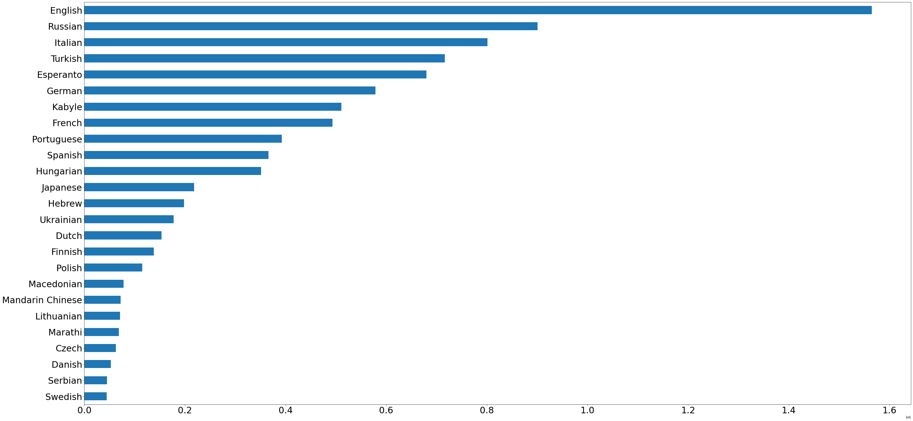
Data Exploration
Bar chart of Top 25 Languages (by samples submitted)
English 1564640 Russian 900863 Italian 801269 Turkish 716418 Esperanto 680054 German 578833 Kabyle 511111 French 493072 Portuguese 392730 Spanish 366050 Hungarian 351355 Japanese 218246 Hebrew 198105 Ukrainian 177547 Dutch 153405 Finnish 138135 Polish 115424 Macedonian 77945 Mandarin Chinese 71952 Lithuanian 70906 Marathi 68633 Czech 62881 Danish 52592 Serbian 45177 Swedish 44210

Slide 8
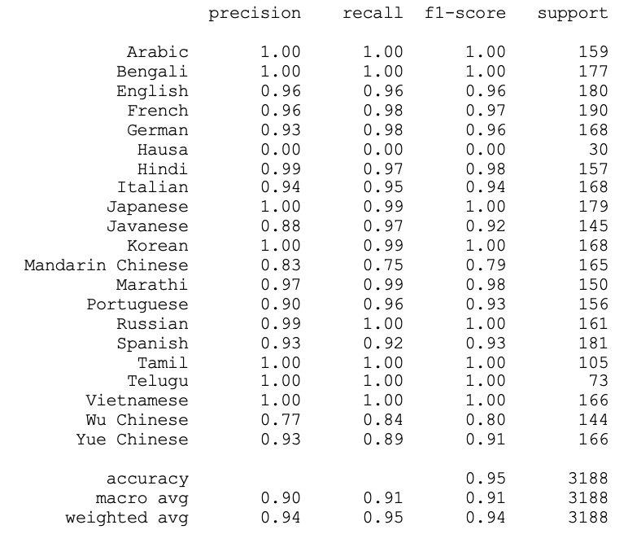
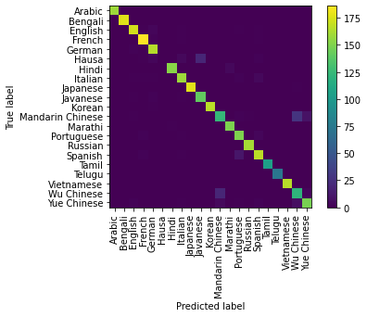
Data Modeling Top 21 Languages by Population

Slide 9
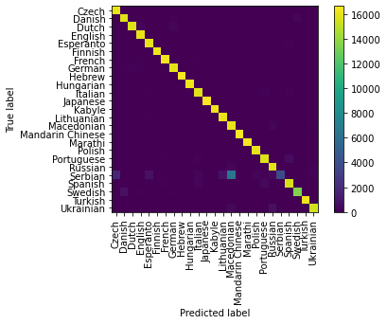
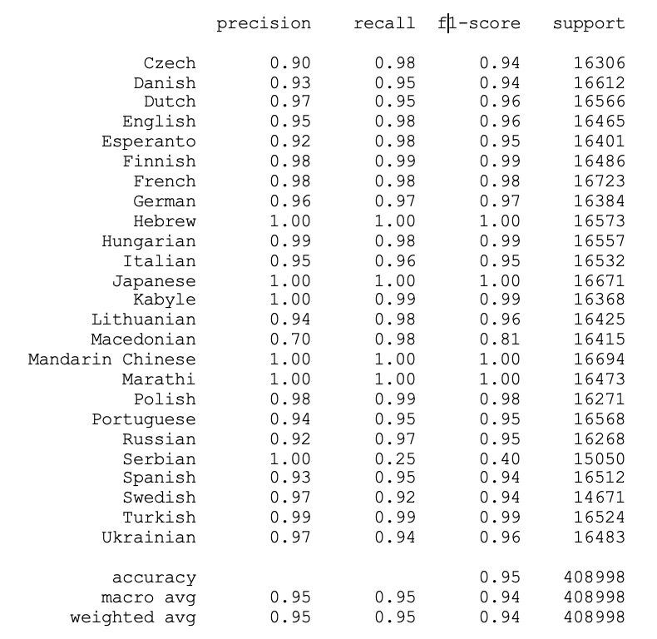
Data Modeling Top 25 Languages by Number of Samples

Slide 10
Conclusion/Implementation
95% accuracy for the models is great, especially considering the languages that are often confused are at least somewhat similar
Implementation of the models would depend on use case of the model
Would want to train and deploy model that includes relevant languages for business problem but have confidence the appropriate model would have similar results

Slide 11

QUESTIONS

Slide 12
How did you decide which languages to select? Why did you do it that way?

Slide 13
Why did you decide to use bigrams instead of whole words for your model?

Slide 14
Is there anything you would do to improve this project?
Try different number of characters in ngram or a different model
Include translations to make project even more useful and applicable
Attempt training model using audio

